Slide 1
Exercise 1 – Toffoli gate
Gate decomposition BoSeong Kim
IBM Quantum Challenge 2021

Slide 2
Table of Contents
Qubit
Basic Gates
Composition of Gates
IBM Quantum Challenge 2021

Slide 3


Bit
What is a bit?
IBM Quantum Challenge 2021

Slide 4



Qubit
What is a qubit?
IBM Quantum Challenge 2021

Slide 5

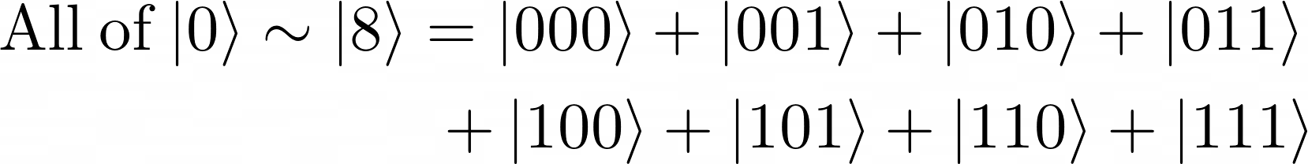

Qubit
For example…
IBM Quantum Challenge 2021

Slide 6

Qubit
Amplitude and phase
IBM Quantum Challenge 2021

Slide 7
Qubit
Why not?

Slide 8
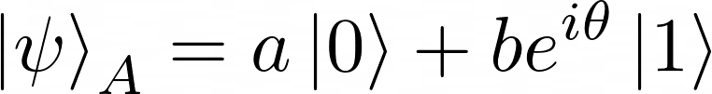

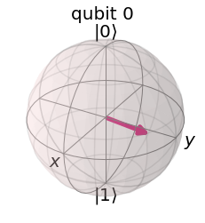
Qubit
Bloch sphere
Represents just a single qubit.
Not the whole information included.
But shows well how the gates work
IBM Quantum Challenge 2021

Slide 9
Matrix Representation
How we represent qubits and gates by matrix
IBM Quantum Challenge 2021

Slide 10

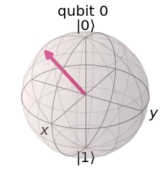
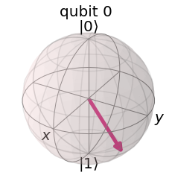

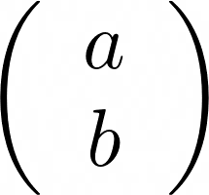
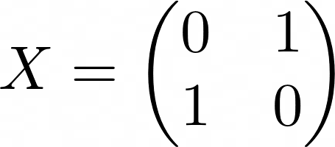
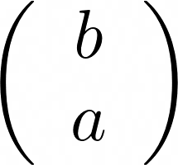
Basic Gates
X gate
IBM Quantum Challenge 2021

Slide 11
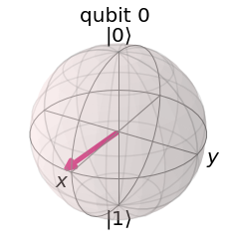

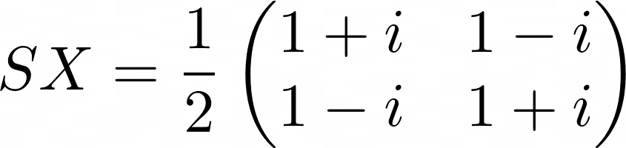
Basic Gates
SX = Square-root X gate
IBM Quantum Challenge 2021

Slide 12
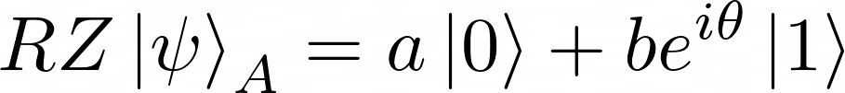
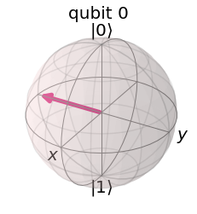
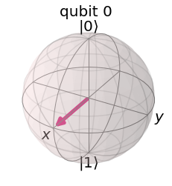

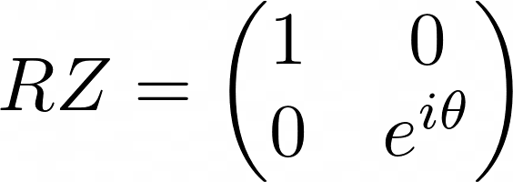
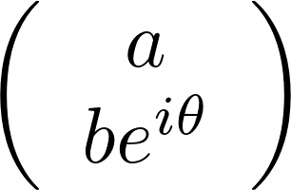
Basic Gates
RZ = Rotation around Z gate
IBM Quantum Challenge 2021

Slide 13
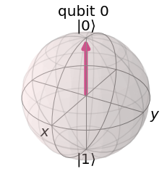
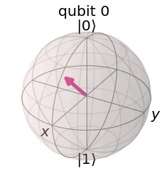


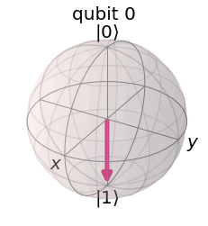
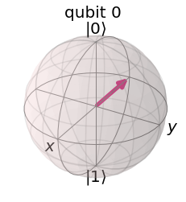
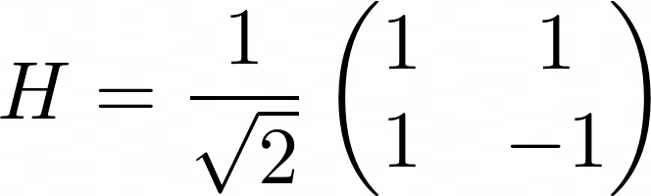
Basic Gates
H = Hadamard gate
IBM Quantum Challenge 2021

Slide 14
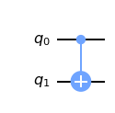
Basic Gates
CX = Controlled X = Controlled NOT = CNOT gate
IBM Quantum Challenge 2021

Slide 15
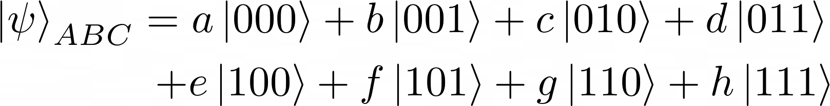
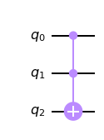
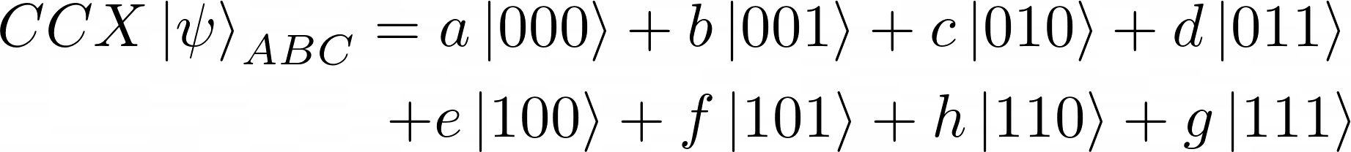
Basic Gates
CCX = Controlled controlled X = Toffoli gate
IBM Quantum Challenge 2021

Slide 16
Single Qubit Gate
Single qubit gates are 2x2 unitary matrix
IBM Quantum Challenge 2021

Slide 17
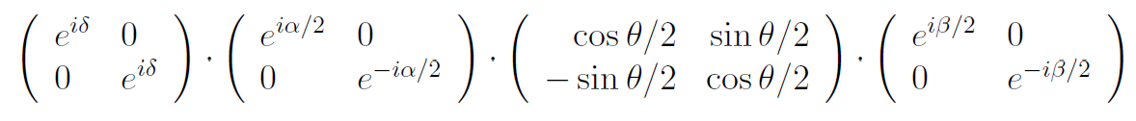
Decomposition of Unitary Matrix
Any unitary matrix can be decomposed to..
IBM Quantum Challenge 2021

Slide 18
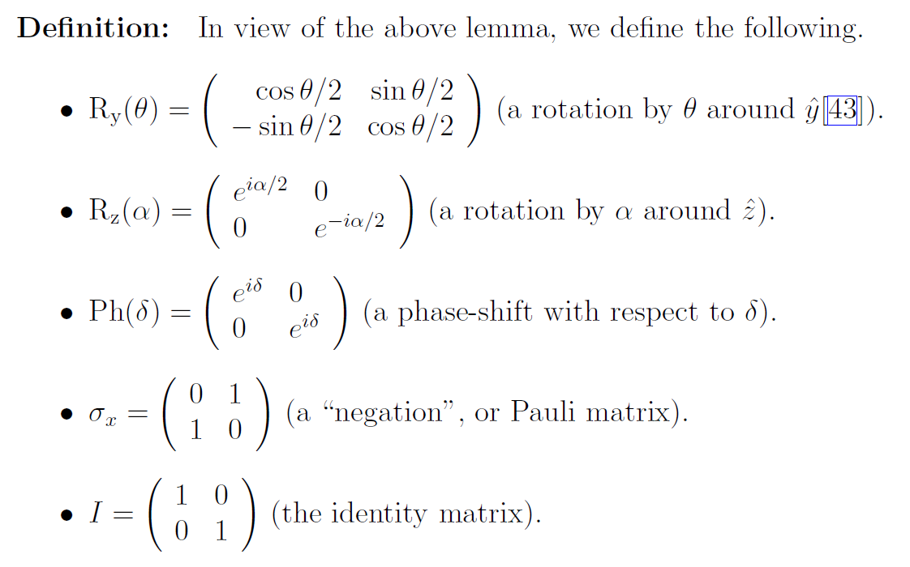
Operation Definition
Definition description
IBM Quantum Challenge 2021

Slide 19
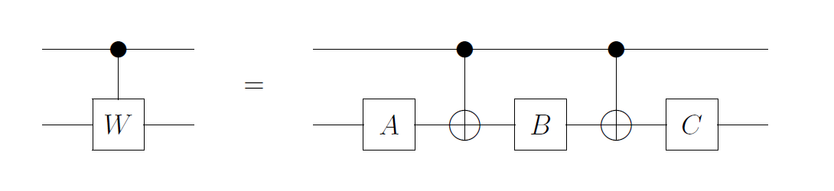
Controlled Unitary Gate
Proposition
IBM Quantum Challenge 2021

Slide 20
Controlled Unitary Gate
Description
IBM Quantum Challenge 2021

Slide 21
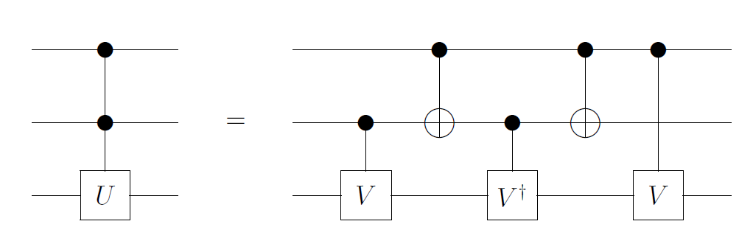
Controlled-controlled Unitary Gate
Proposition
IBM Quantum Challenge 2021

Slide 22
Controlled-controlled Unitary Gate
Description
IBM Quantum Challenge 2021

Slide 23
Using Quantum Composer
Using Quantum Composer
Running on real backend
Transpiled circuit (!)
IBM Quantum Challenge 2021

Slide 24
Reference
IBM Quantum Challenge 2021. Exercise 1 – Toffoli gate. https://challenges.quantum-computing.ibm.com/iqc21
Barenco, et al. Elementary gates for quantum computation. https://arxiv.org/abs/quant-ph/9503016
IBM Quantum Challenge 2021

Slide 25
Thank you
BoSeong Kim
IBM Quantum Challenge 2021

